Slide 1
Hangman game
C Language

Slide 2
Features:
One person enters the word to be guessed by another person.
The other person starts guessing by guessing alphabets of the word.
The hangman is updated with every wrong guess.
User gets to make six wrong guesses.
Game can be played again and again till the user wants.

Slide 3
Algorithm:
Start.
Declare variables needed, (for user input and loops) of suitable data types.
Make a user defined function to display the hangman at start and (however needed) when the player guesses wrong.
Set the color of display for the console.
Using a loop repeat the following steps till the user wants to play the game.
Take input for the word to be guessed.

Slide 4
Algorithm:
Clear screen and display the hangman and the instructions for the game.
Take input for guess using a loop.
If guess is correct update the scores.
If guess is not correct clear screen and show the updated hangman and the scores.
When user guesses word or the user makes six wrong guesses display whether they won or were hanged.
Ask the user if they want to play again.
End.

Slide 5
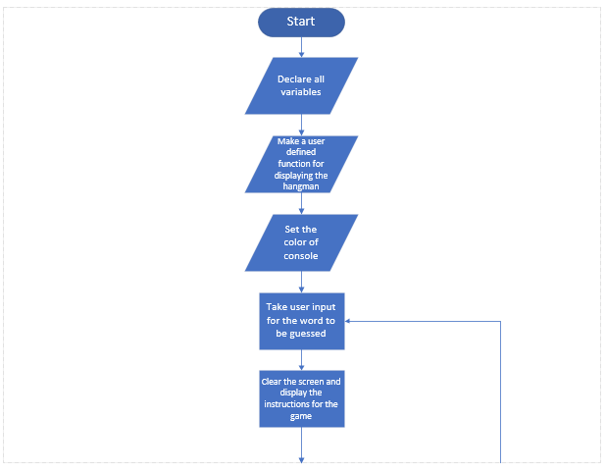
Flowchart:

Slide 6
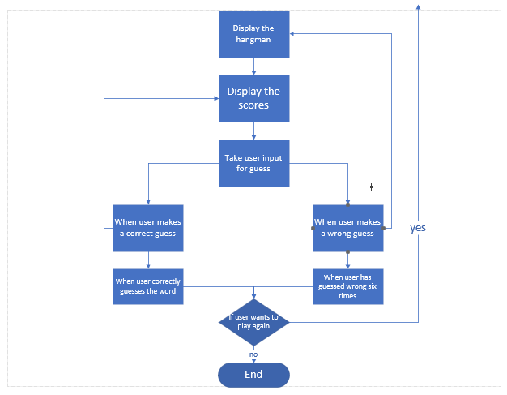
Flowchart:

Slide 7
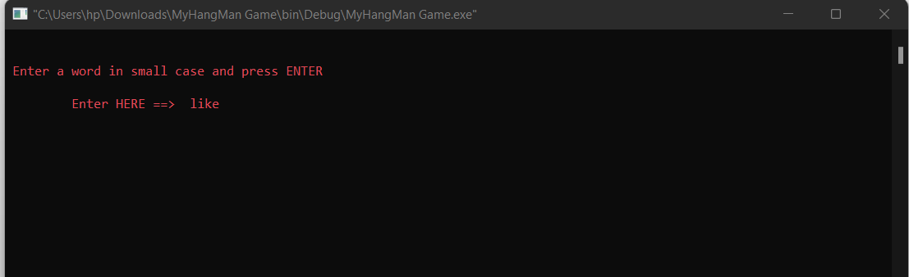
Output:

Slide 8
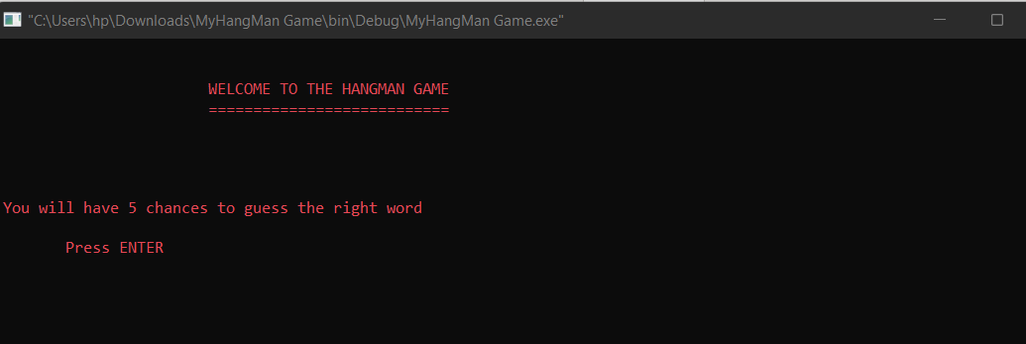
Output:

Slide 9
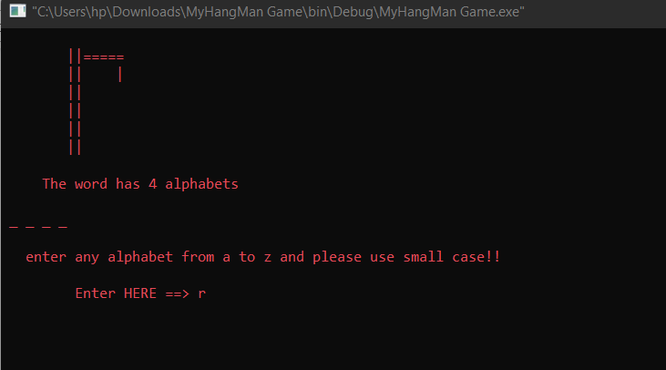
Output:

Slide 10
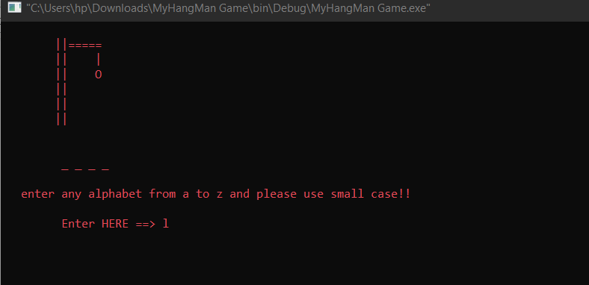
Output:

Slide 11
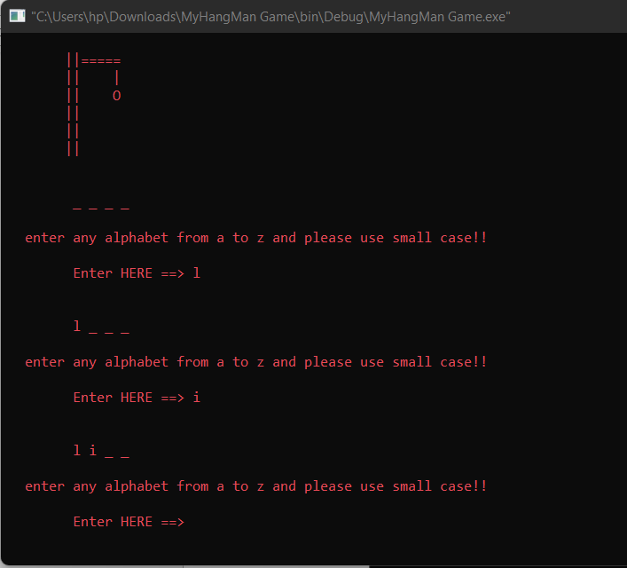
Output:

Slide 12
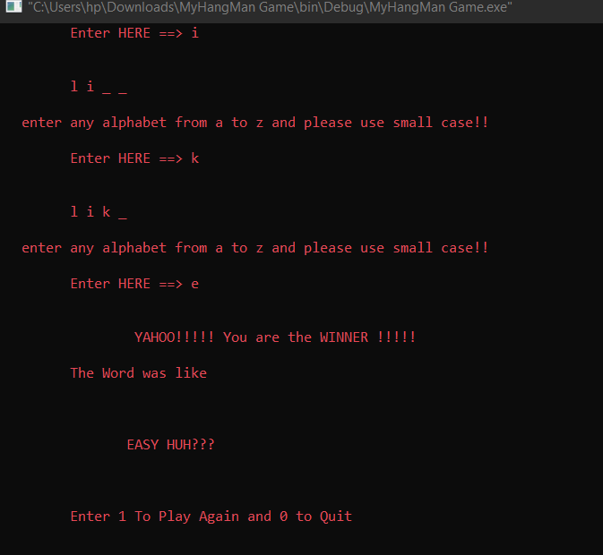
Output:

Slide 13
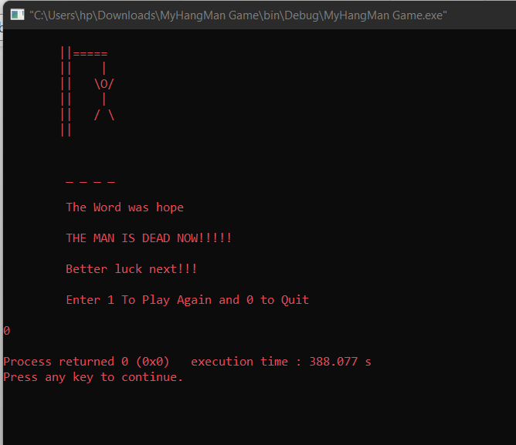
Output:

